Slide 1



Figures 14 and 15 - 2-step floating catchment area method
Figure 14, step 1
population within search radius of nature
Figure 15, step 2
nature within search radius of population
R_{j}
P_{k}
distance
i -> j
P_{k}
radius d₀
R_{j}
radius d₀
A_{i}
R_{j}
P_{k}
R_{j}
P_{k}
distance
j -> k
R_{j}
R_{j}
P_{k}
R_{j}
Notes:
UG: Given an urban nature pixel, all population pixels with the search radius are searched. The urban nature/population ratio for this pixel is calculated using the nature pixel’s area divided by the total population within the search radius, weighted according to the selected search kernel’s distance-based weighting. Then, centered on each pixel in the population raster, all the natural pixels within its distance-weighted catchment are searched. All of the of these natural pixels are summed to calculate the urban nature supply per capita to every population pixel.
Roy Remme adds: 2SFCA – It wasn’t directly clear from the slides, but it is probably good to explain why we take that approach for supply rather than simply the amount of nature within a radius of a home. Using a gravity-based approach takes into account the weighted availability of nature. Officially I think we even use the enhanced 2SFCA (or E2FSCA) because we add in the decay function.

Slide 2
Decay function
section
radius d₀
more likely to visit
= higher weight
less likely to visit
= lower weight
Notes:
UG: People use nature areas more frequently if they are closer to their home. This frequency diminishes as distance increases, and can be different for different population groups (age, income, etc). This is referred to as ‘travel distance decay’.
4 different decay functions are provided, which are used to weight the search radius when calculating supply. Nature pixels that are closer to a population receive higher weight, and nature pixels that are further away receive lower weight.

Slide 3




Radii defined per urban nature class
Small, local "pocket" park
people visit from nearby
Larger park with more features
people visit from further away
smaller radius
d_{0,r1}
larger radius
d_{0,r2}
X
Notes:
UG: Urban nature has different types. Pocket parks provide convenient recreation experience nearby, while municipal parks attract people from more distant places. If the user has data to split the types of urban nature and to adjust the travel distance for each type of urban nature, the accessibility of each type of urban nature to pixel can be calculated using the class-specific radius.
Otherwise, a single uniform search radius is used for all nature land cover types.

Slide 4
Radii defined per urban nature class
Small, local "pocket" park
people visit from nearby
Larger park with more features
people visit from further away
smaller radius
d_{0,r1}
larger radius
d_{0,r2}
X
Notes:
UG: Urban nature has different types. Pocket parks provide convenient recreation experience nearby, while municipal parks attract people from more distant places. If the user has data to split the types of urban nature and to adjust the travel distance for each type of urban nature, the accessibility of each type of urban nature to pixel can be calculated using the class-specific radius.
Otherwise, a single uniform search radius is used for all nature land cover types.

Slide 5



Radii defined per population group
Younger population
longer travel distance
Elder population
shorter travel distance
larger radius
smaller radius
X
Notes:
UG: The user has the option to provide population characteristics indicating the proportion of the total population that belong to a given population group within each administrative unit. Examples of population groups might be age or income brackets.
This example defines young and elder populations, where younger people are likely to travel further, while elders are likely to stay closer to home. So, an elder living in the same apartment building as a younger person will have access to less greenspace just based on willingness or ability to travel. Similar differences may be found by income level or other demographics.
Supply/demand/balance results will be summarized for each of the defined population groups.
Otherwise, results will be summarized only for the total population.

Slide 6
Not used in UG, just leaving here in case we want to add more detail to the decay graphics later

Slide 7
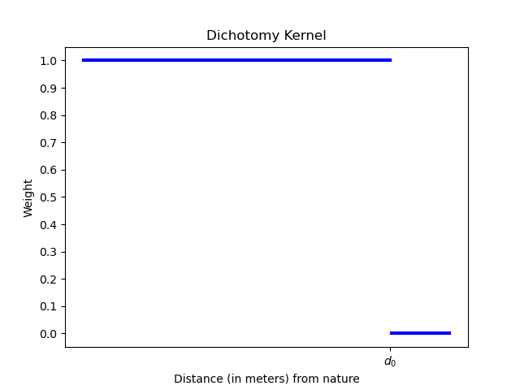
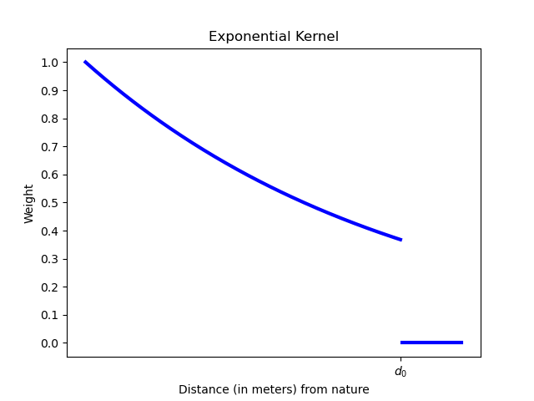
Travel distance decay functions
d₀ is distance set by the user
Dichotomy
Exponential
More likely to visit
Yes, will visit
Weight
Weight
Less likely to visit
No
No
Travel distance (meters)
d₀
Travel distance (meters)
d₀
Notes:
Dichotomy: considers all pixels within the search distance d0 from a pixel with nature to be equally accessible.
Exponential: distance-weighted exponential decay function, where people are more likely to visit the nature closest to them, with likelihood falling off exponentially out to the maximum radius d0.

Slide 8
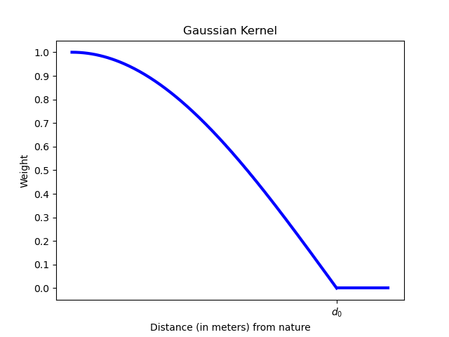
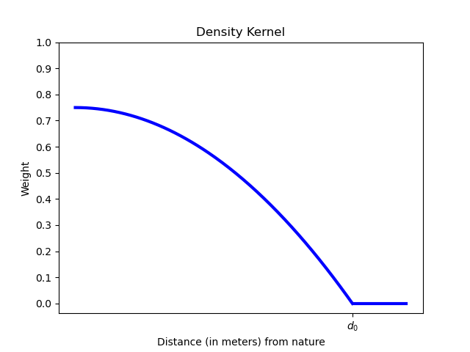
Travel distance decay functions
d₀ is distance set by the user
Gaussian
Density
More likely to visit
More likely to visit
Weight
Weight
Less likely to visit
No
Less likely to visit
No
Travel distance (meters)
d₀
Travel distance (meters)
d₀
Notes:
Gaussian: A distance-weighted decay function, where people are more likely to visit the nature closest to them, with likelihood decreasing according to a normal ("gaussian") distribution with a sigma of 3, out to the maximum radius d0.
Density: A distance-weighted decay function, where people are more likely to visit the nature closest to them, with likelihood decreasing faster as distances appoach the search radius d0.

